Slide 1

Interfaces Java - The Complete Reference Herbert Schildt Chapter 9

Slide 2
Outline
Java Interfaces
Defining an Interface
Implementing Interfaces
Nested Interfaces
Applying Interfaces
Variables in Interfaces
Interfaces can be extended

Slide 3
Java Interfaces

Slide 4
Java Interfaces
A Java interface is like a blueprint of a Java class.
Using the interface, you can specify what a class must do, but not how it does it.
It defines a set of methods that a class must implement if it implements that interface.
By providing the interface keyword, Java allows you to fully utilize the “one interface, multiple methods” aspect of polymorphism.

Slide 5
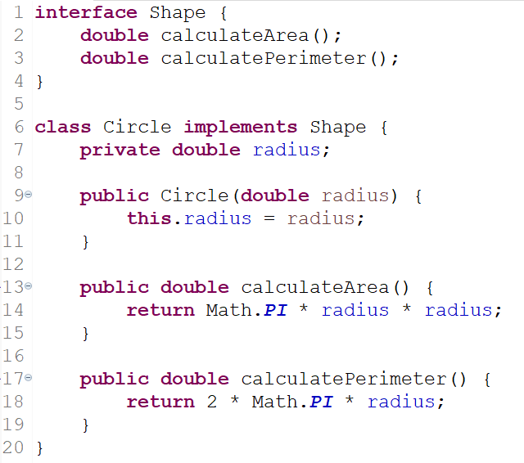
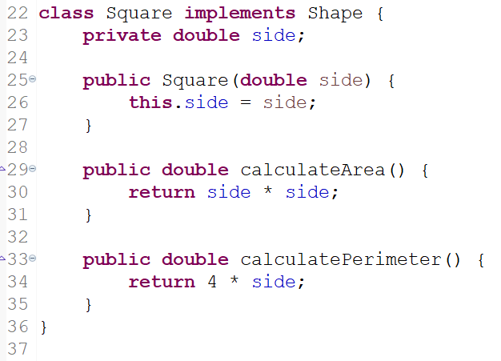
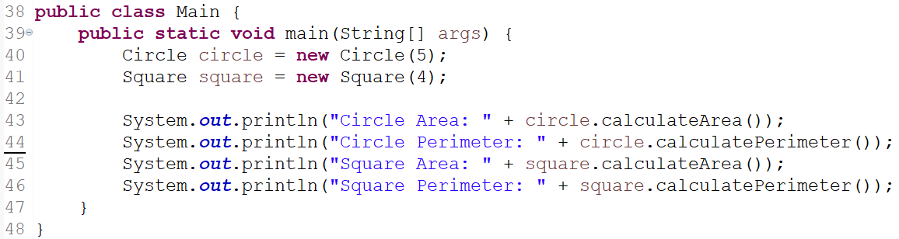
An Example of a Java Interface

Slide 6
Rules of Java Interfaces
Rules of Interfaces
Interfaces are syntactically similar to classes, but they lack instance variables (fields or member variables), and, as a general rule, their methods are declared without any body.
Once a Java interface is defined, any number of classes can implement that interface.
One class can implement any number of interfaces.
To implement an interface, a class must provide the complete set of methods required by the interface.
That means the class must provide bodies for all the methods in the interface.
Each class is free to determine the details of its own implementation.

Slide 7
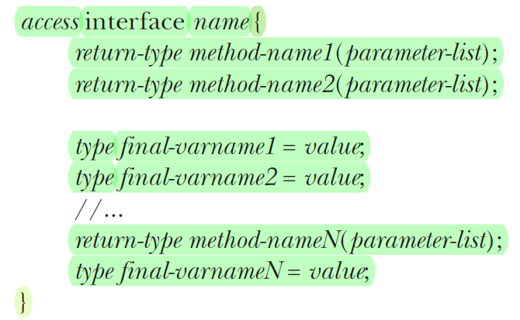
Defining a Java Interface
The general form of an interface:
When no access modifier is included, then default access (package-level) results, and the interface is only available to other members of the package in which it is declared.
When it is declared as public, the interface can be used by any other code.
In this case, the interface must be the only public interface declared in the file, and the file must have the same name as the interface (similar to class definition).
Interface name can be any valid identifier.
NOTE: Prior to JDK 8, an interface could not define any implementation whatsoever. This is the type of interface that the preceding simplified form shows, in which no method declaration supplies a body. Beginning with JDK 8, it is possible to add a default implementation to an interface method. However, default methods constitute what is, in essence, a special-use feature, and the original intent behind interface still remains.

Slide 8
Defining a Java Interface
Variables can be declared inside of interface declarations. (refer to the general form)
They are implicitly final and static, meaning they cannot be changed by the implementing class.
They must also be initialized.
All methods and variables are implicitly public.

Slide 9
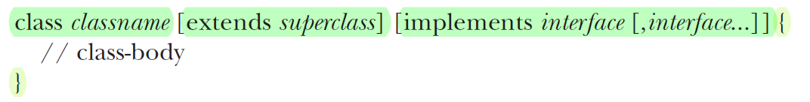
Implementing Java Interfaces
Once an interface has been defined, one or more classes can implement that interface.
To implement an interface, include the implements clause in a class definition, and then create the methods required by the interface.
If a class implements more than one interface, the interfaces are separated with a comma.
The methods that implement an interface must be declared public.
Also, the type signature of the implementing method must match exactly the type signature specified in the interface definition.

Slide 10
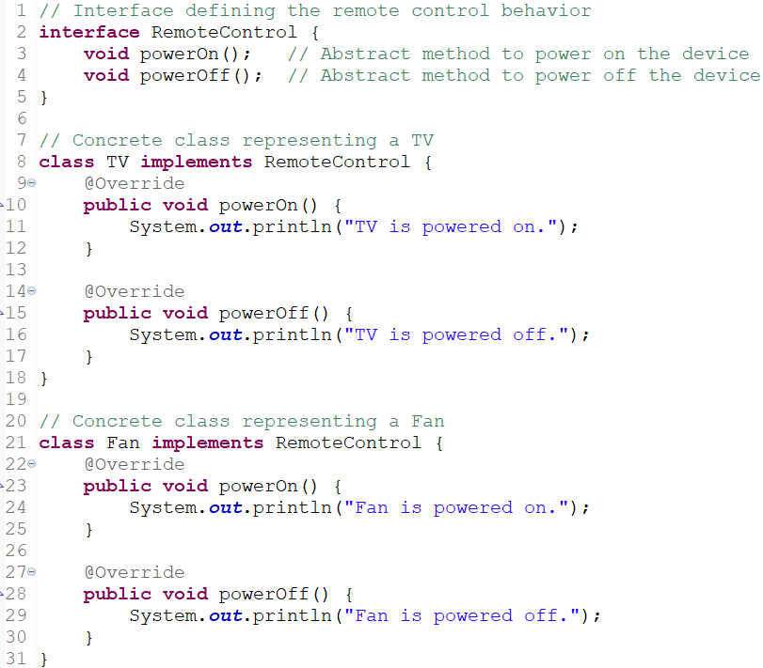
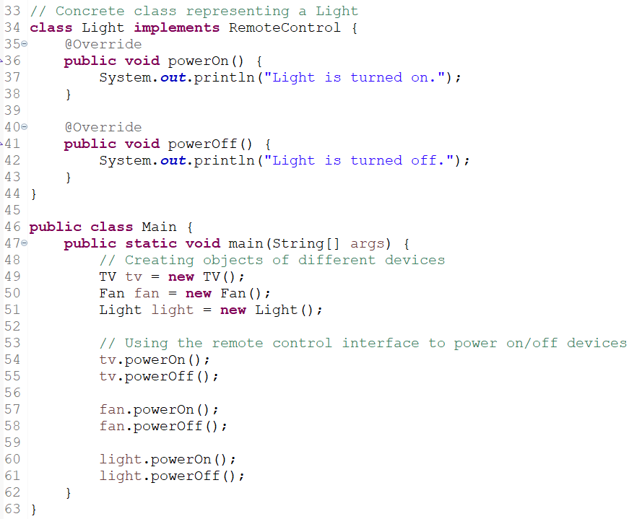
Another Example of a Java Interface

